Slide 1
Exercise 1

Slide 2
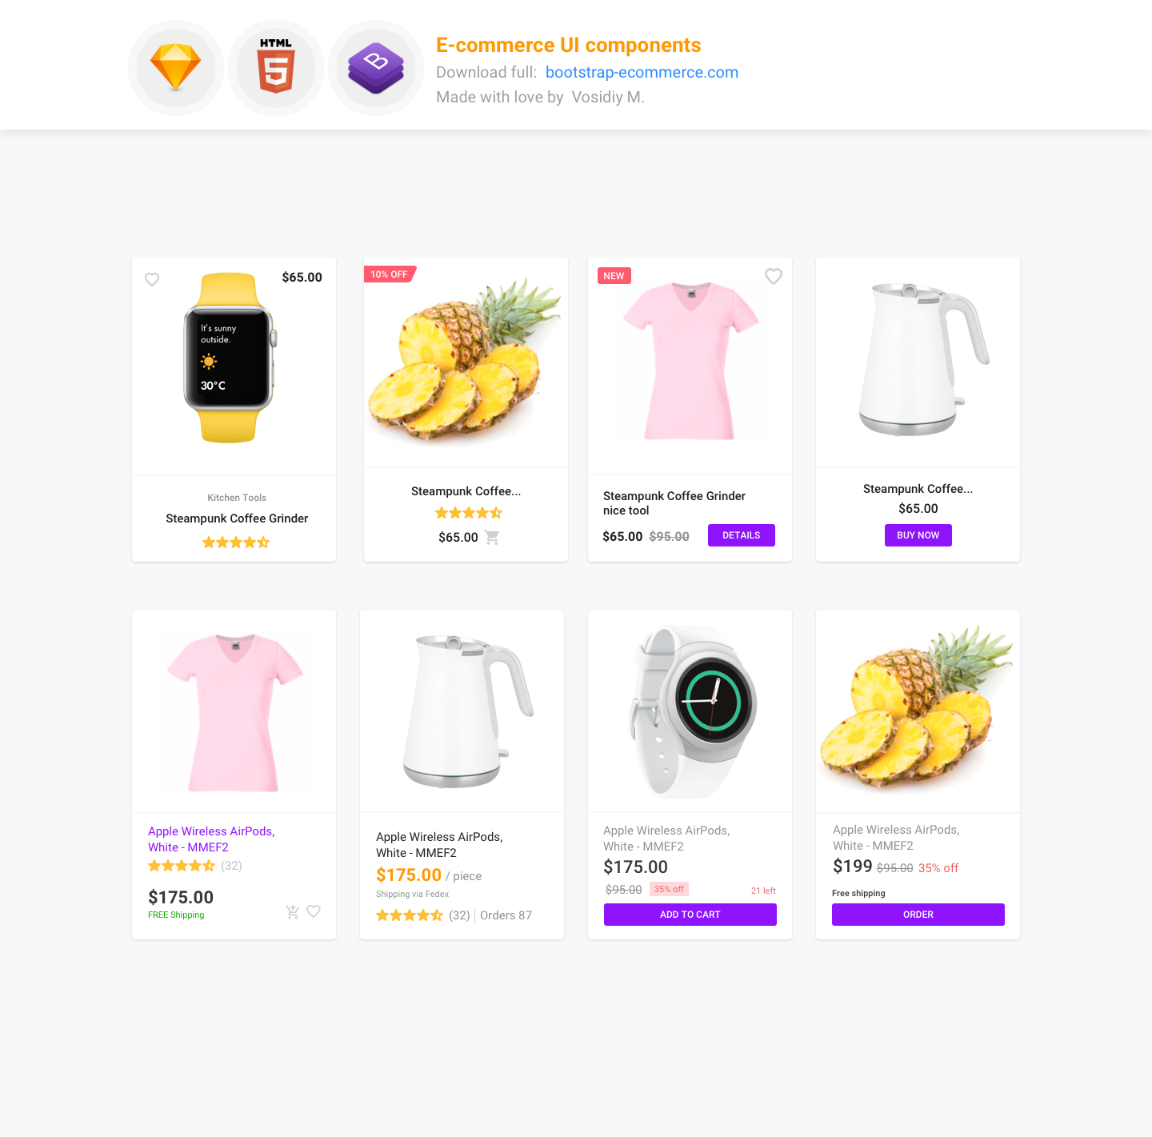
Define the component on this template

Slide 3
TODO: Define and draw components
image
Text
button
Draw card component

Slide 4
image
image
image
image
image
image
image
image
Column component

Slide 5
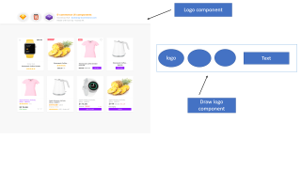
Logo component
logo
Text
Draw logo component

